Slide 1











M365 Coimbatore
M365Coimbatore
#M365Coimbatore
Copilot for developer productivity - Building a MS Graph connector
Arjun Menon, MVP, PnP Team Member
arjunumenon
in/arjunumenon
Brought to you by
Manoj Mittal, Sr. Consultant Microsoft
manojmcan
in/manojmittal12

Slide 2
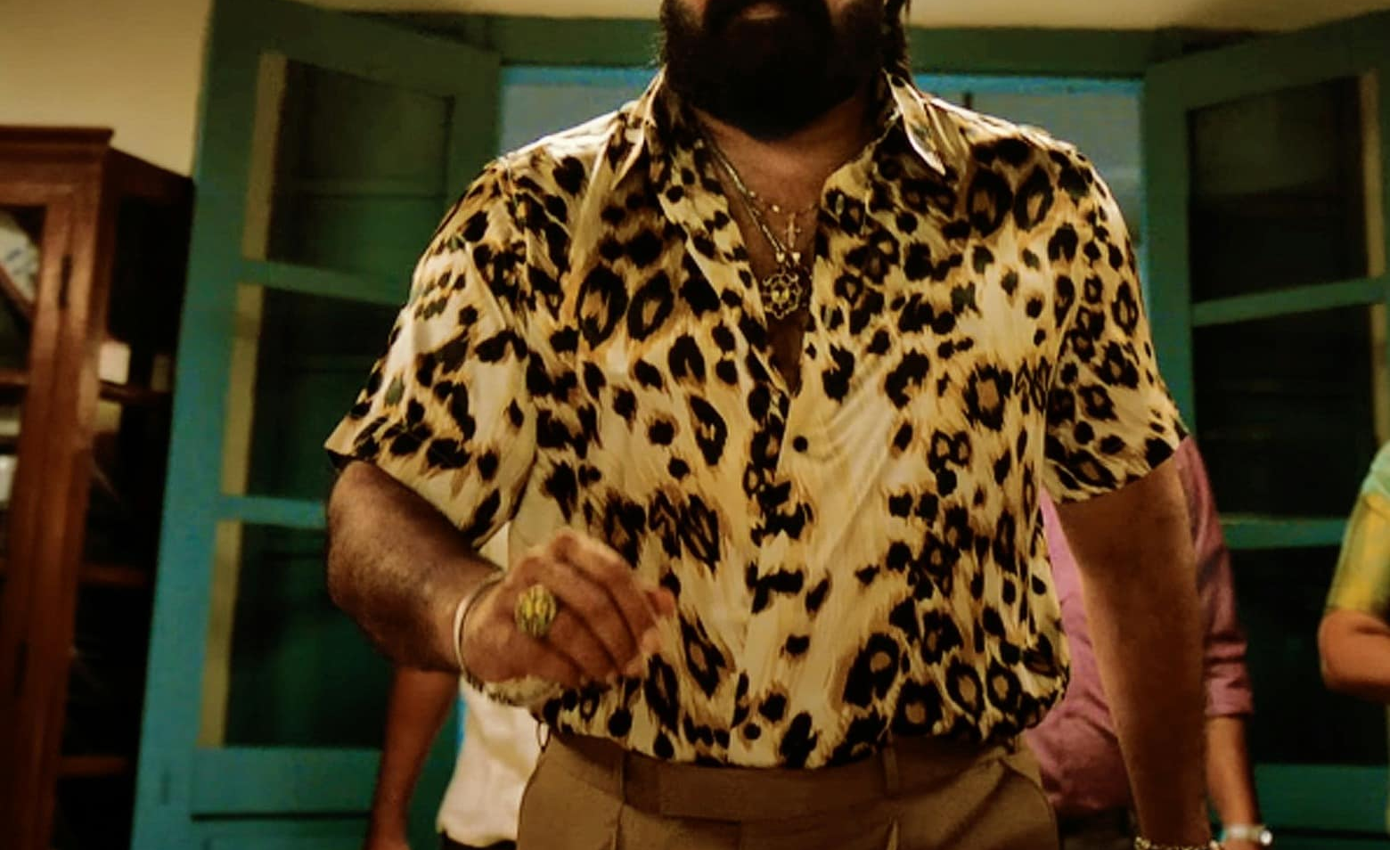

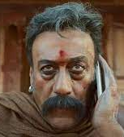
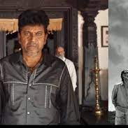
Why Graph Connector
M365 Coimbatore | 2024
Graph Connector. Jailer Metaphor

Slide 3
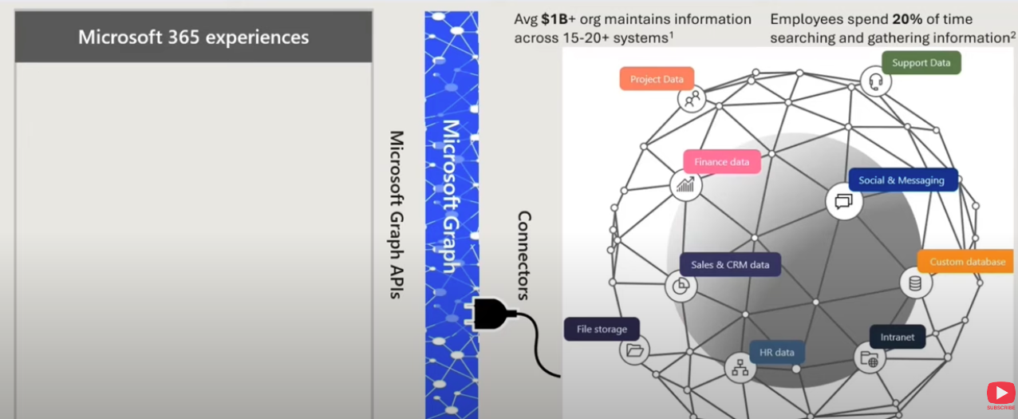

How Graph Connector Functions together
M365 Coimbatore | 2024

Slide 4
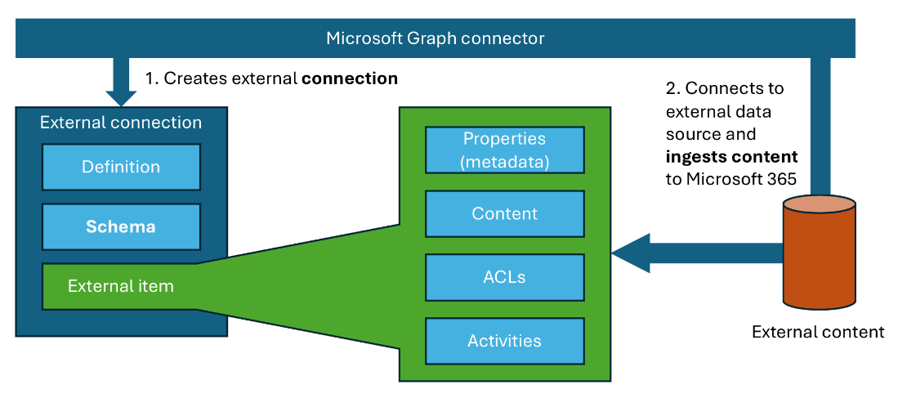
Graph Connector – Building Blocks
M365 Coimbatore | 2024

Slide 5
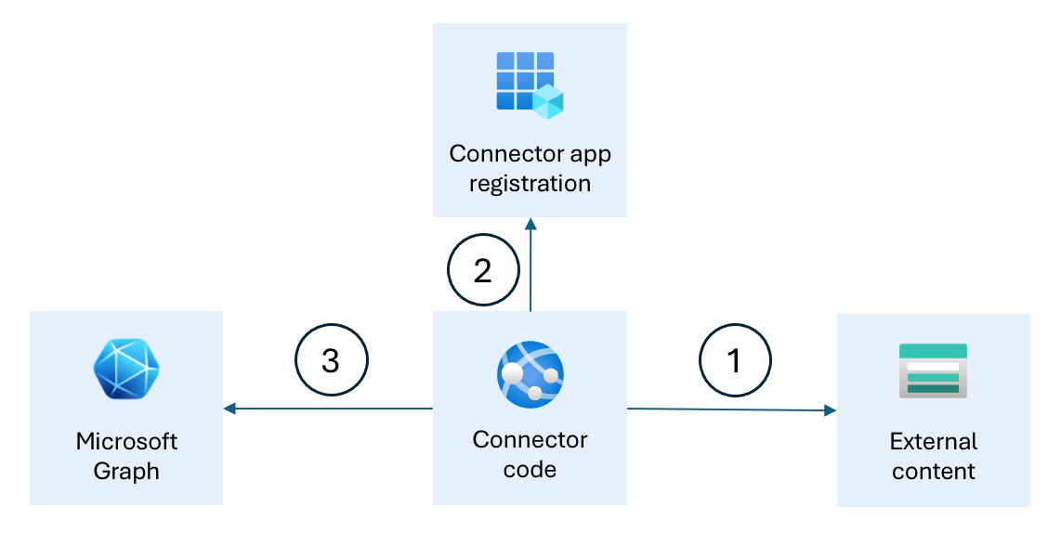
How they come together
M365 Coimbatore | 2024

Slide 6

Artefacts
M365 Coimbatore | 2024
Reference | Link / QR
Demo Artefacts | https://a-um.me/cbe24-repo

Slide 7
M365 Coimbatore
M365Coimbatore
#M365Coimbatore
Questions?

Slide 8

What can we do better
M365 Coimbatore | 2024
https://a-um.me/cbe24-feedback

Slide 9
M365 Coimbatore
M365Coimbatore
#M365Coimbatore
Thank you!!

Slide 10
Slide Title Goes Here
M365 Coimbatore | 2024

